Slide 1
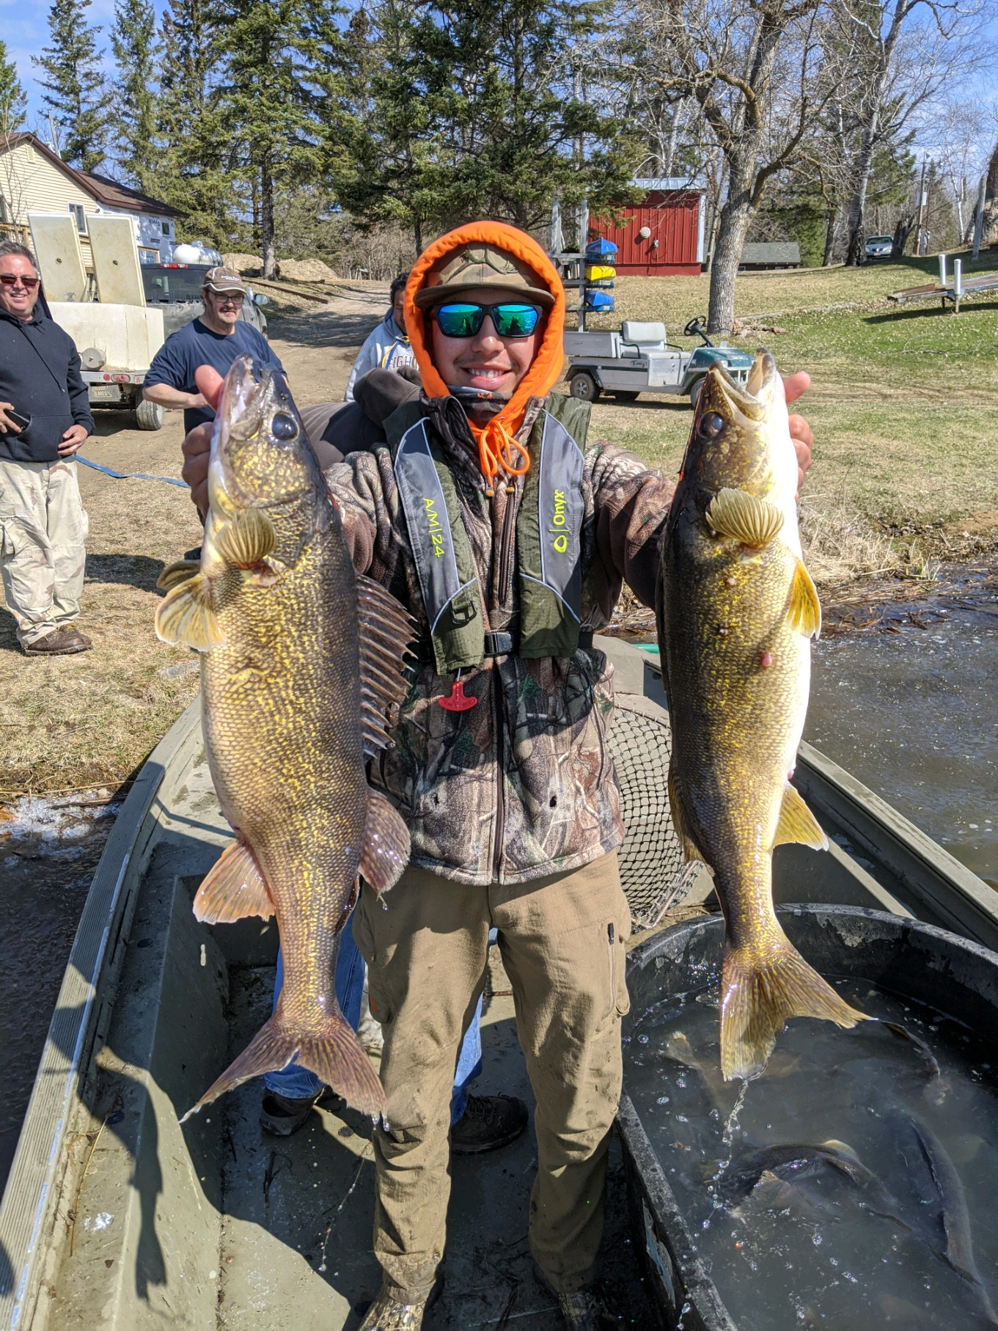
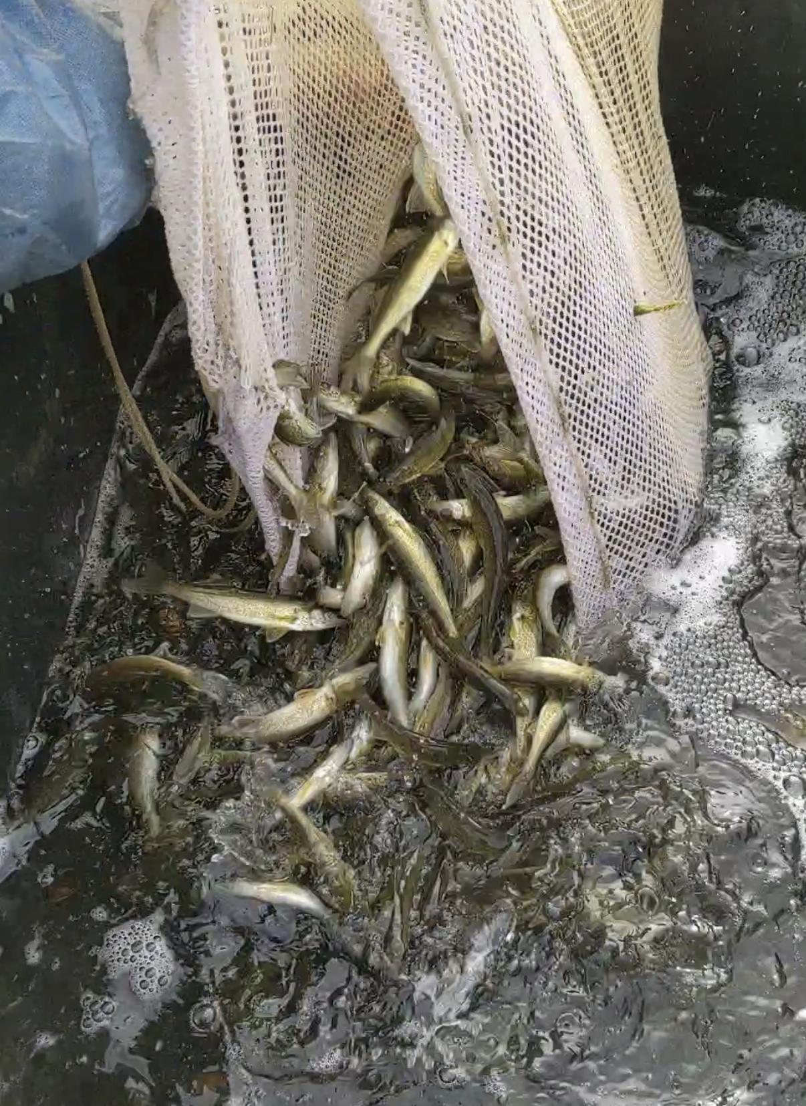
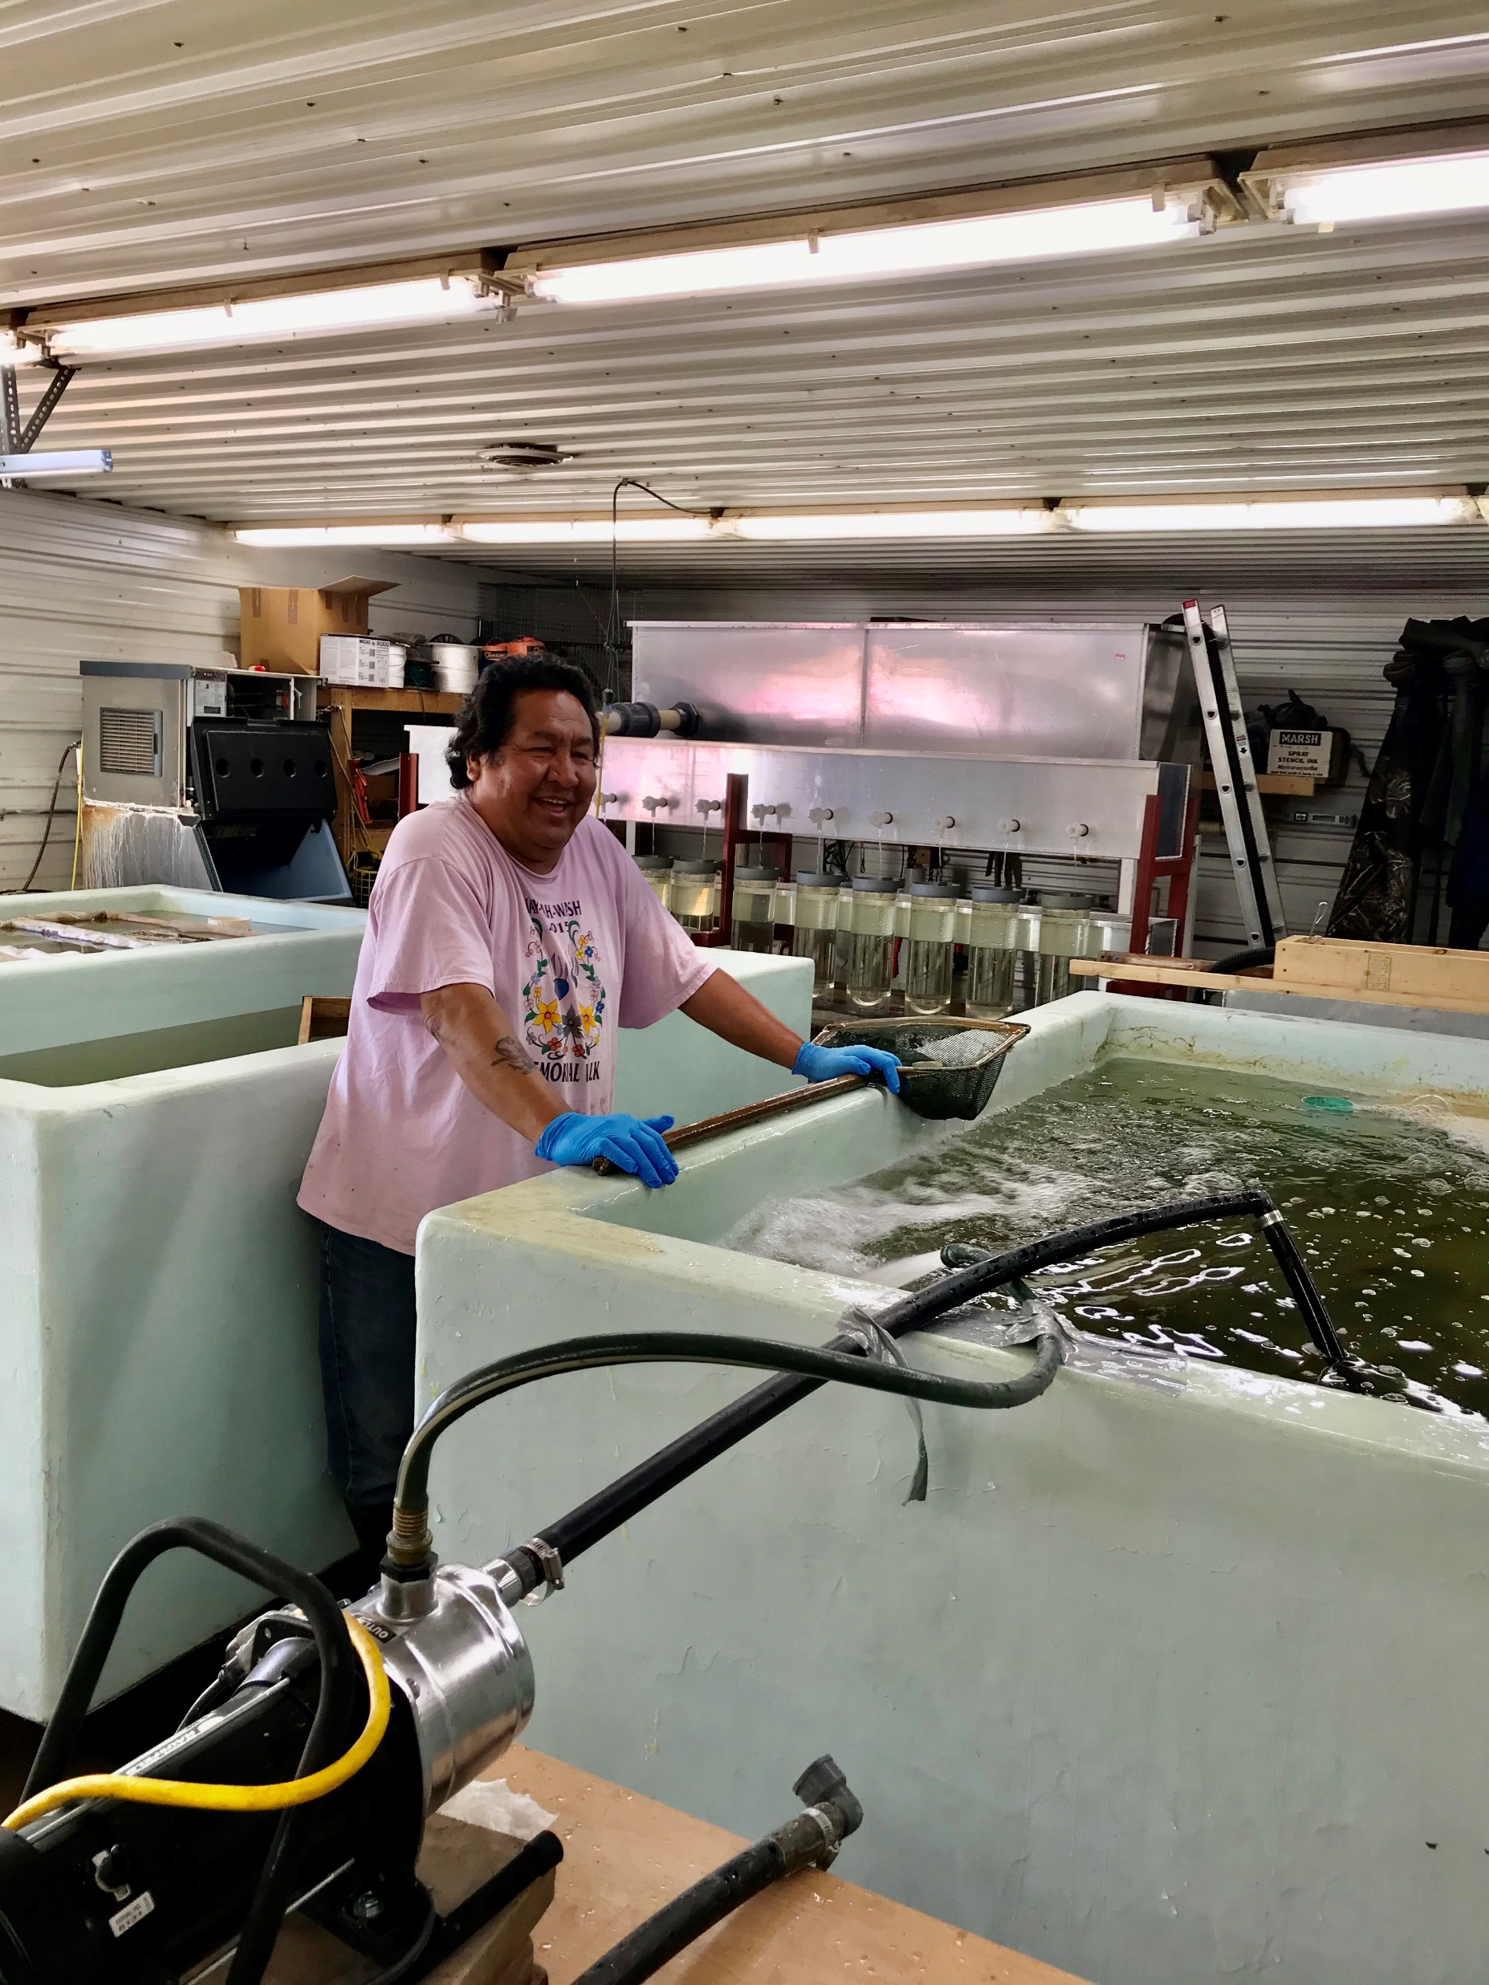
White Earth Fisheries

Slide 2

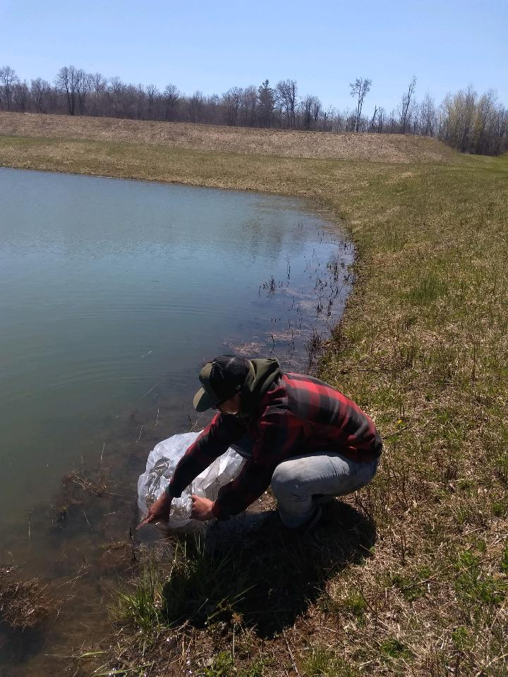
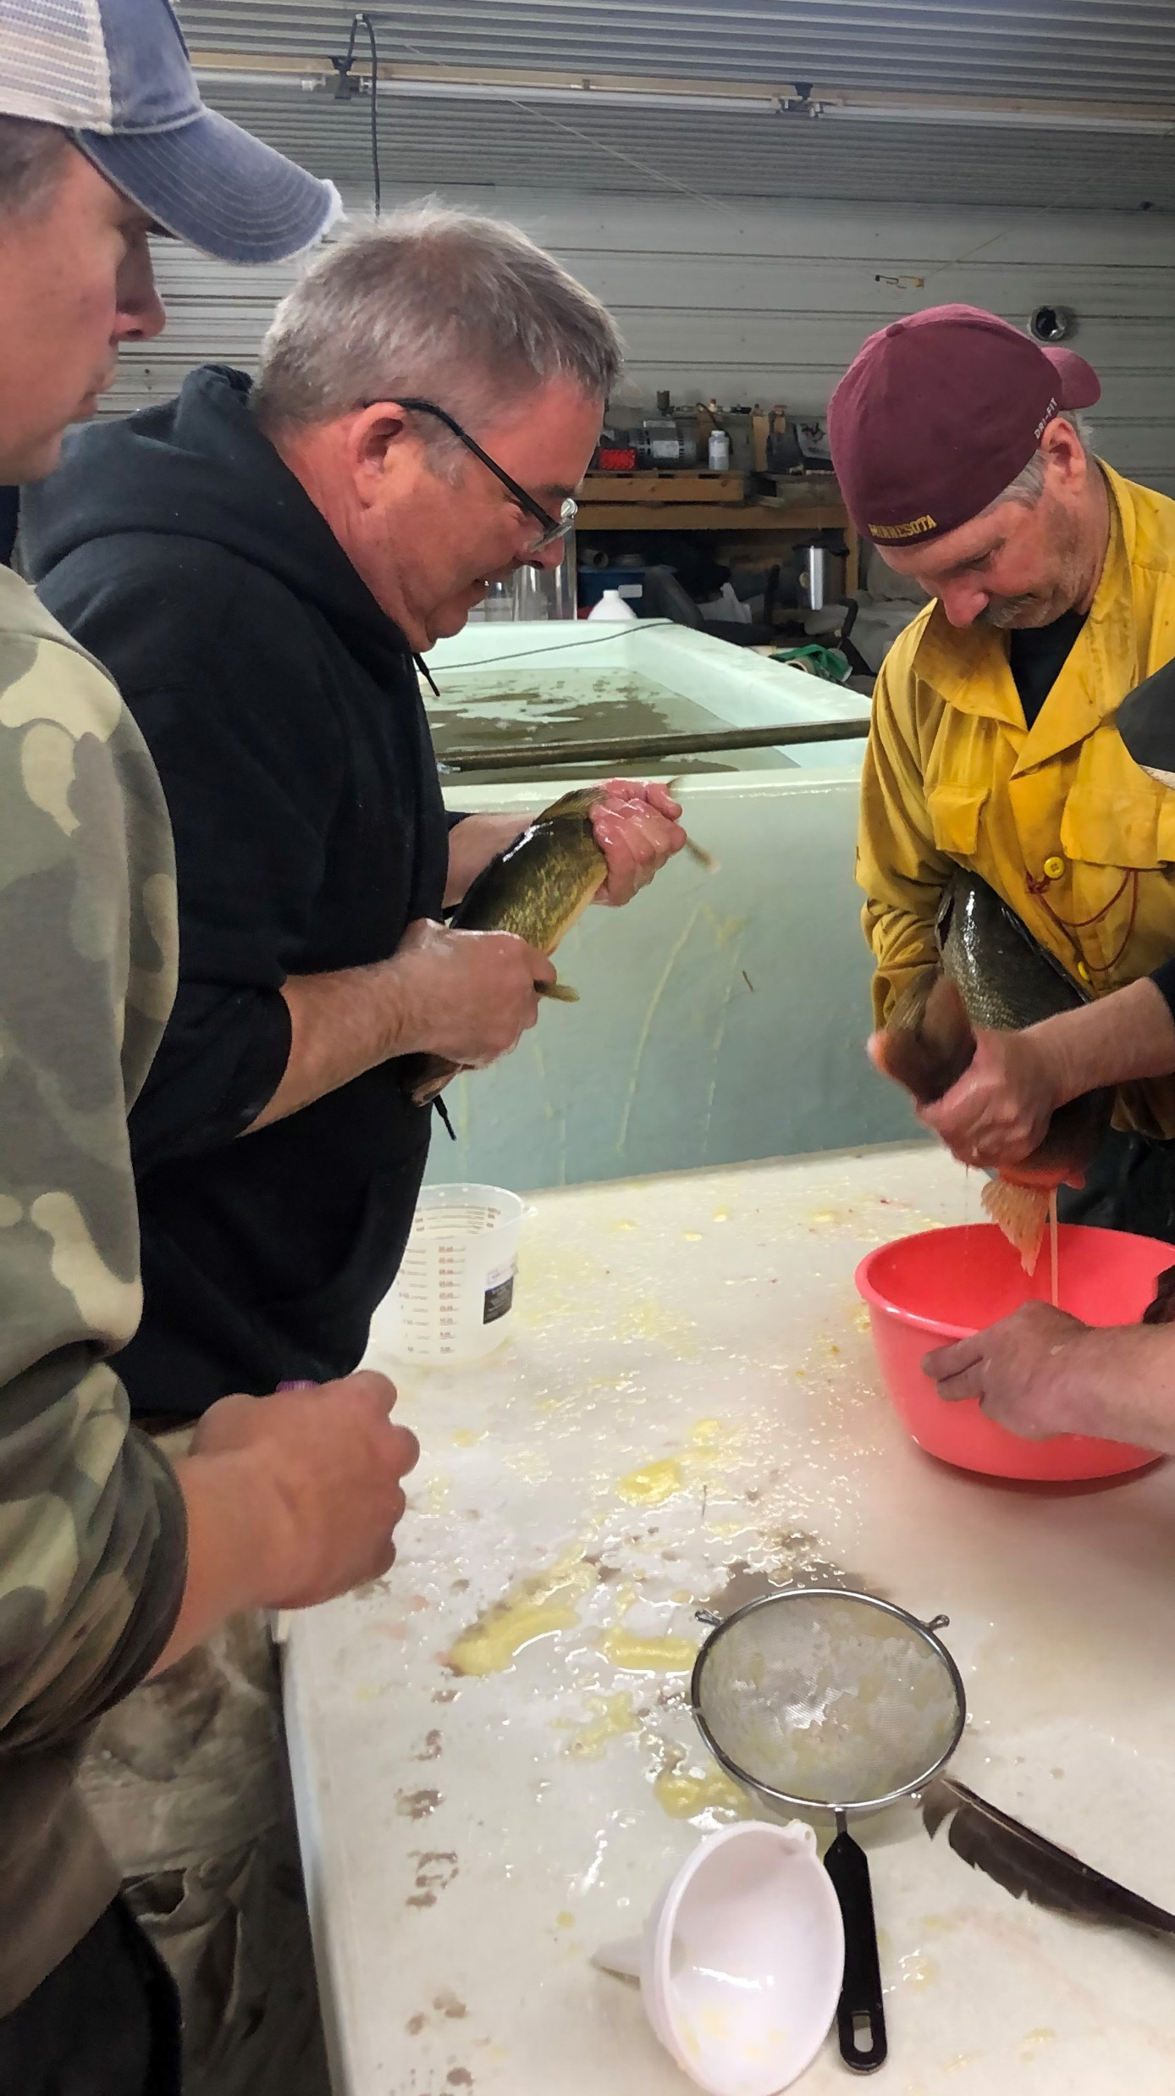
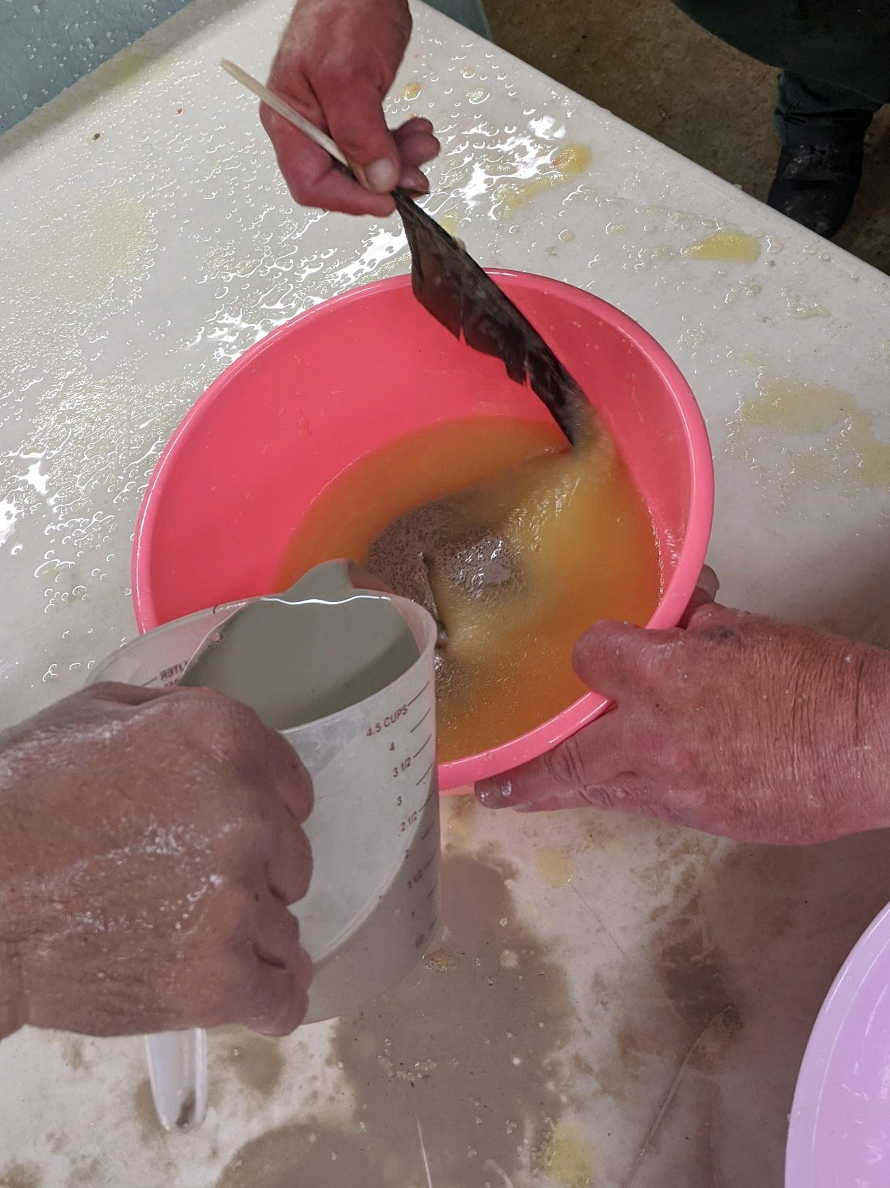
2020 Spring Egg Take
In April of 2020 Walleyes live trapped in Big Elbow and Little Bemidji for egg collection
Walleyes were returned to their source waters after egg collection and fertilization
4 Million Walleye Eggs Collected and fertilized
1.61 Million Walleye Fry Returned
Portion of hatched fry returned to Big Elbow Lake and Little Bemidji Lake
200,000 into White Earth’s drainable ponds
Remainder placed into natural rearing ponds for fall collection

Slide 3
Source Lake Fry Stock 225,500
Big Elbow – 160,000
Little Bemidji – 65,500

Slide 4
2020 Spring Stock
132,464 Walleye
21 Lakes Stocked

Slide 5
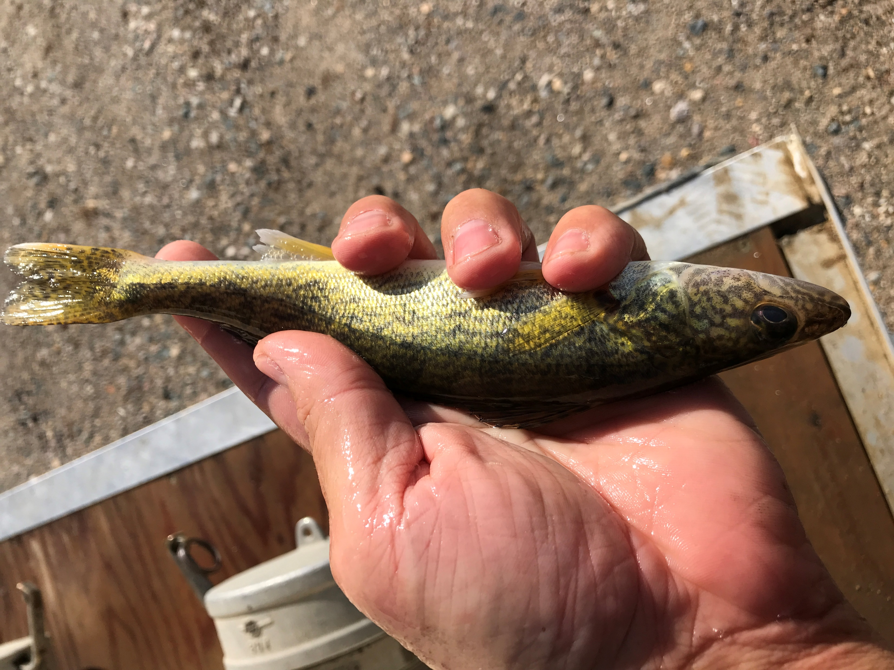
2020 Fall Stock
89,540 Walleyes
18 Lakes Stocked

Slide 6
Last 5 Years
1,102,213 Walleyes Stocked

Slide 7
White Earth’s Netting Lakes
Average Size of White Earth’s Lakes Open to Netting
799 Acres

Slide 8
White Earth and Leech Lake Acreage Comparison for Netting

Slide 9

Lakes Under 1,000 Acres
White Earth only has a few lakes over 1,000 acres in size
75% of White Earth’s Lakes open to netting are under 1,000 Acres
30% of White Earth’s Lakes open to netting are under 500 Acres
25% of White Earth’s Lakes open to netting are under 300 Acres
Lakes under 1,000 acres are potentially vulnerable to extended periods of harvest
  This includes all methods of harvest
Current stocking and seasons are sustaining populations, but changes may impact this.

Slide 10
Historical Water Temperature of White Earth’s Lakes Open to Netting
Water Temp is the Key Component

Slide 11
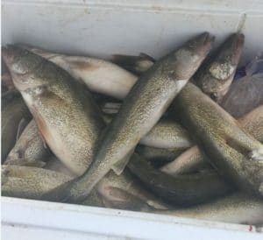
Water Temperature
Fish taken from gill net under 42º F Water
Red Gills
Firm fillets
No decay present
Fish appear fresh

Slide 12
Water Temperature
Fish taken from gill net at 60º+ F Water
White Gills
Flesh texture "Mushy”
Onset of decay detected
24 Hour Gill Net Set in Warm Water
  Fish caught in the net during the last few hours of the set (less time in net) would be edible
  Fish caught in the net during the first initial hours (longer time in net) may not pass as edible
    Increased risk for potential waste due to soaking in warmer water temperatures.

Slide 13
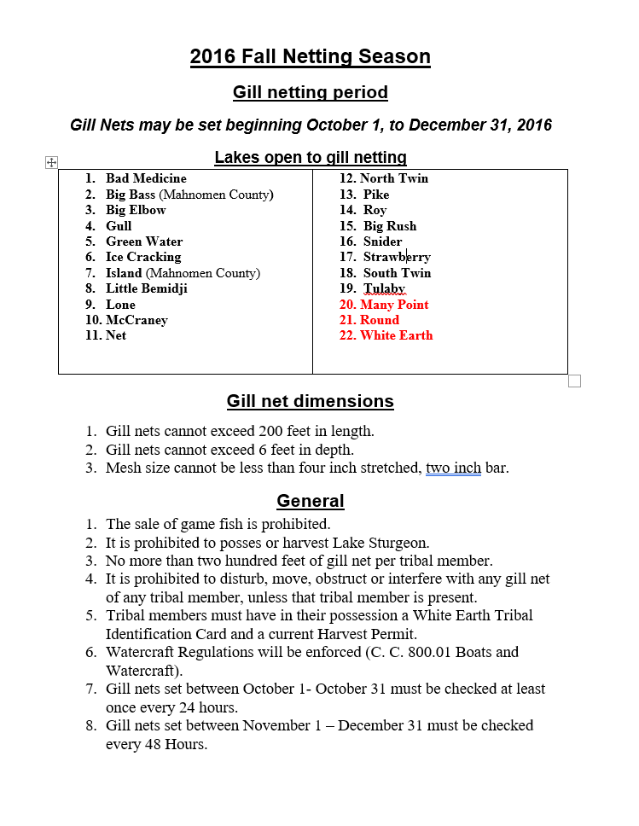
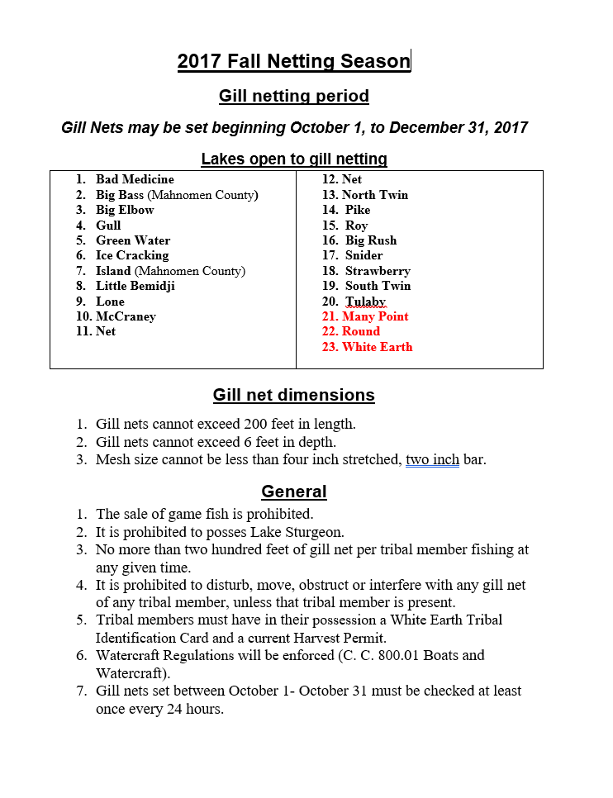
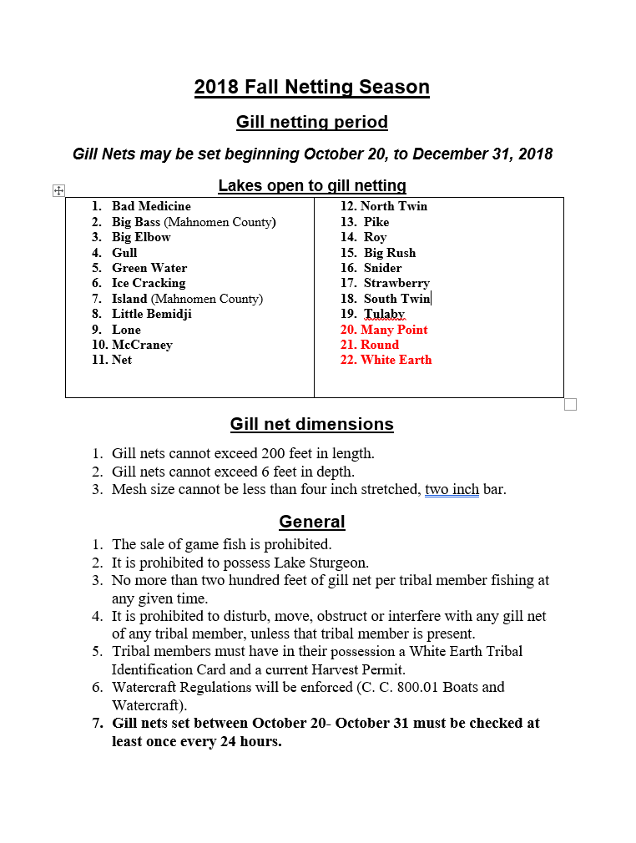
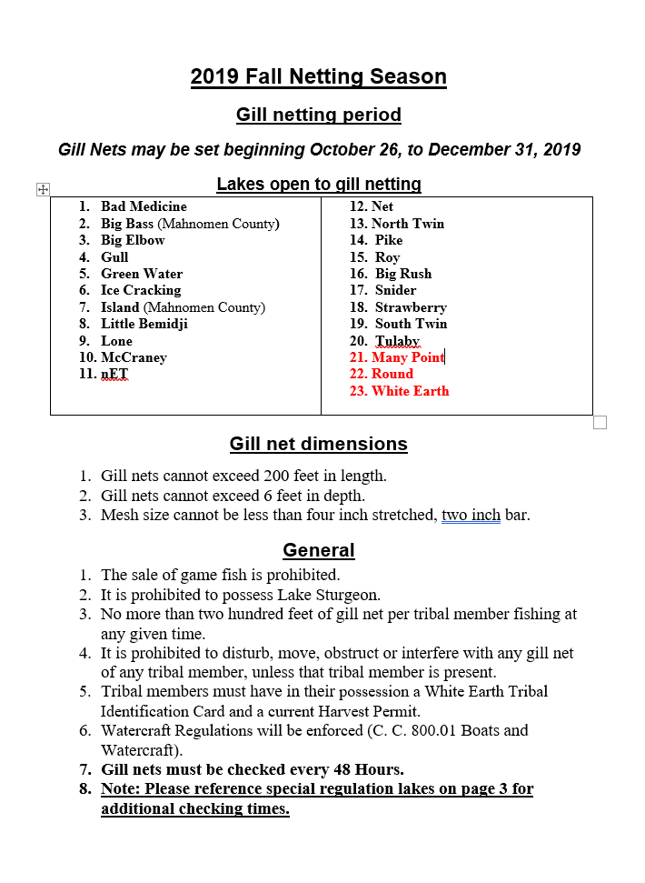
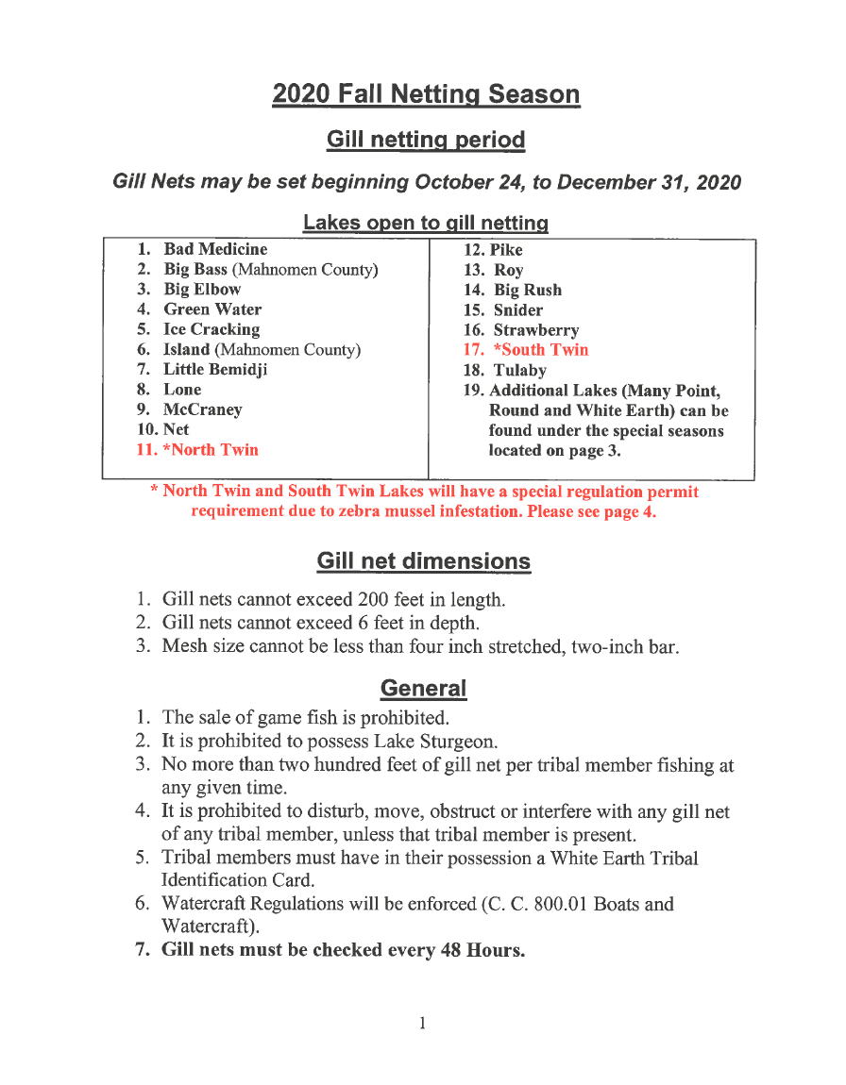
Netting Seasons 2016 - 2020

Slide 14
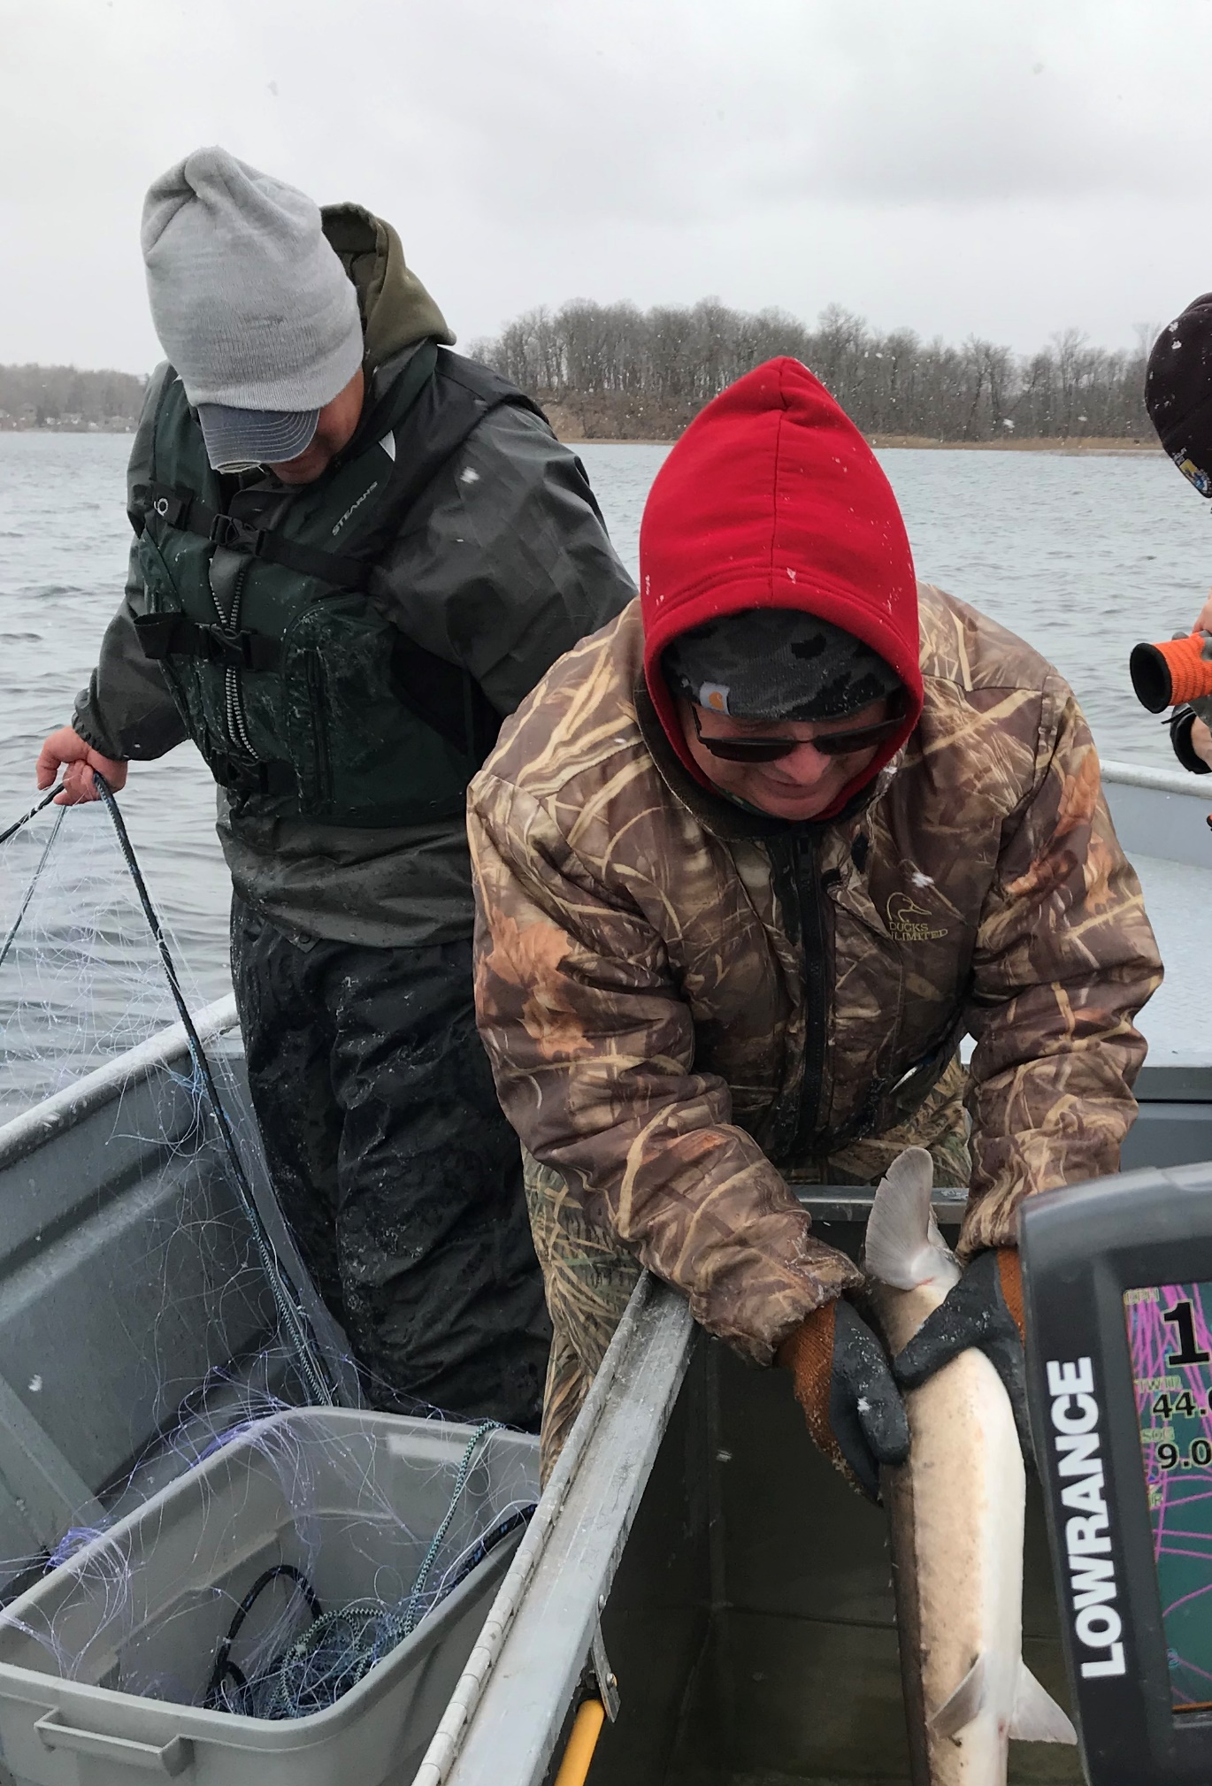
Historical Netting Seasons
2007
  October 20 – December 31
2012
  October 20 – December 31
2014
  October 18 – December 31

Slide 15
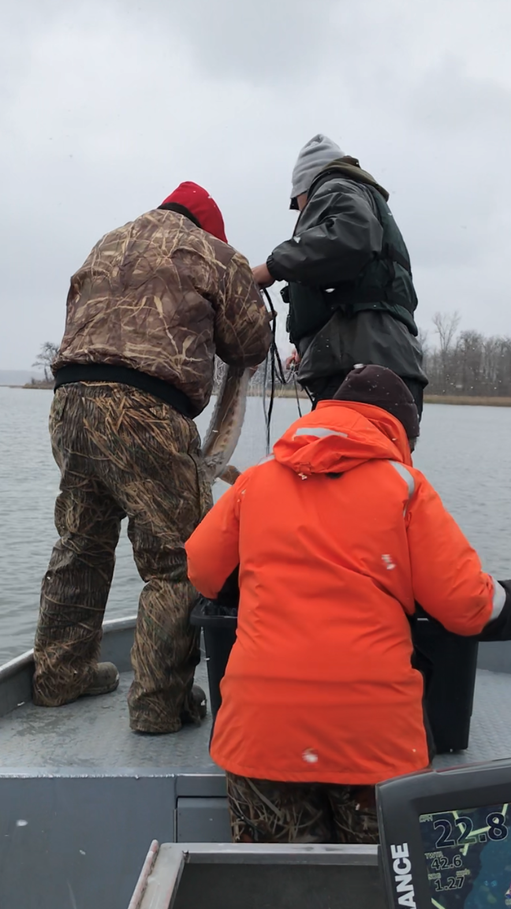
Last 5 Approved Netting Seasons
2016
  October 1 – December 31
  Implementation of earlier netting season
2017
  October 1 – December 31
2018
  Netting season moved back to traditional start date due to concerns over water temps
  Regular Season October 20 – December 31
  First Year Implementation Elder Netting October 6-19
2019
  Zebra Mussels found in Twin Lakes
  Elder Season October 12 - 25
  Regular Season October 26 – December 31
2020
  Elder Season October 10 - 23
  Regular Season October 24 – December 31

Slide 16
Netting Seasons
Recommended Regular Netting Season
  Allows 10-11 weeks of netting per season
    70 to 77 Days
  With Elder netting seasons total increases to 12-13 weeks of netting per season
    84 to 91 days total
    Approximately 23% to 25% of the year is open to netting by members
  AIS infested lakes are open but are subject to additional actions to prevent spread of these harmful species.
    North and South Twin are open for 30 days of netting
  Always an option to extend the netting season on the back end after December 31

Slide 17
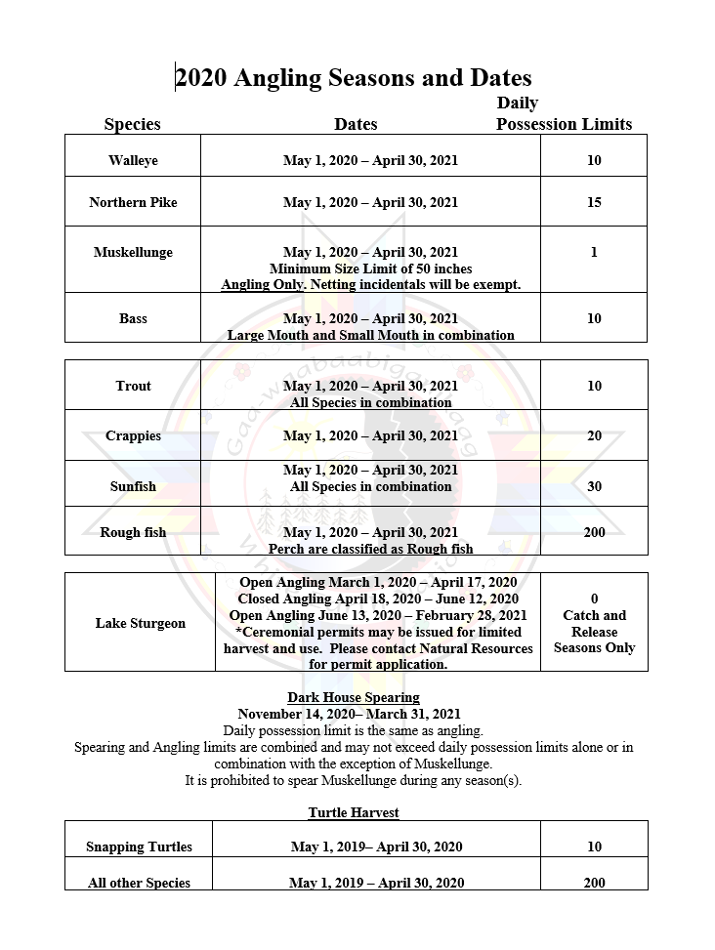
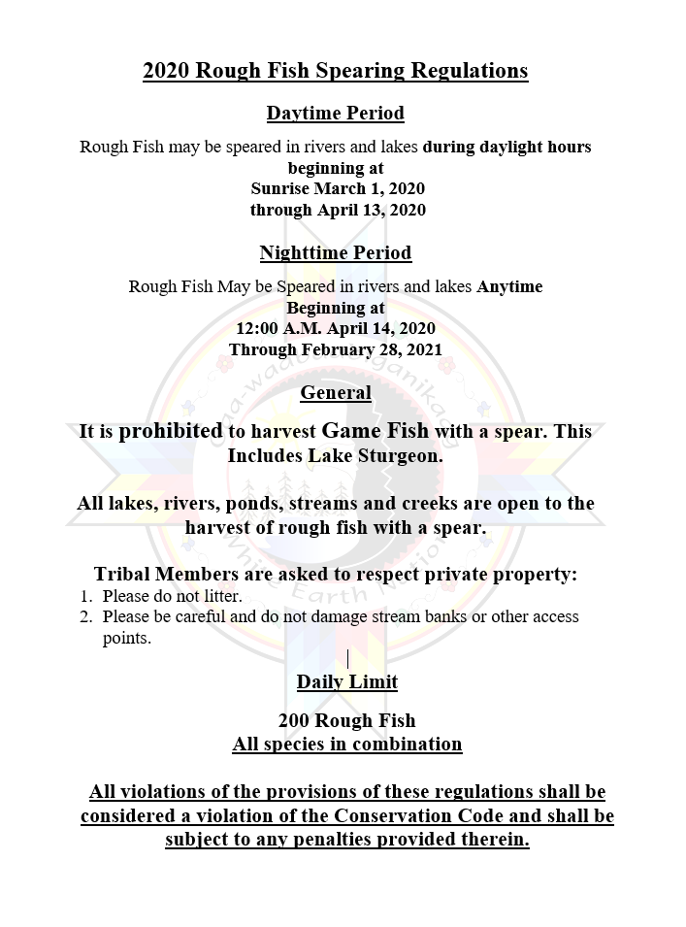
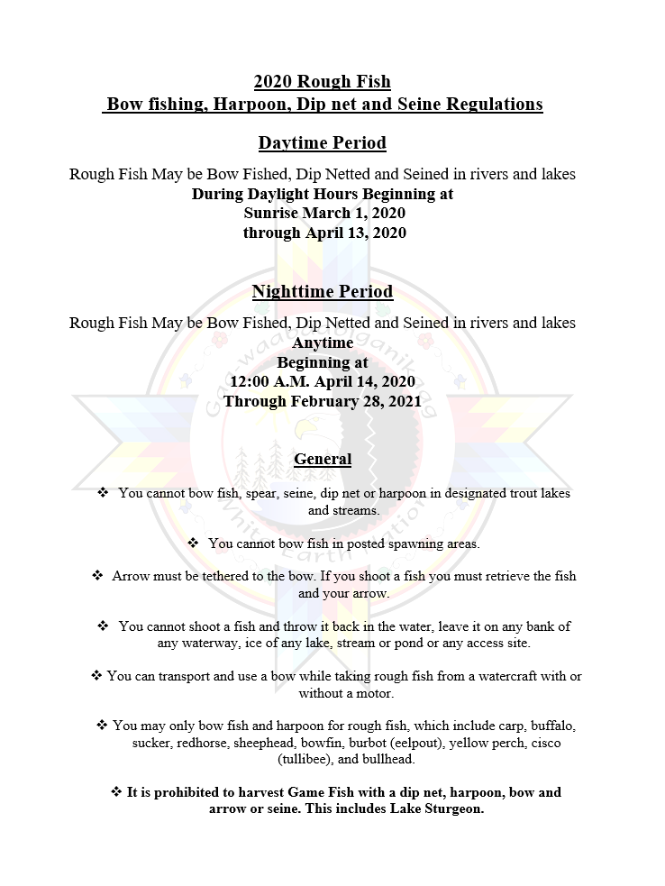
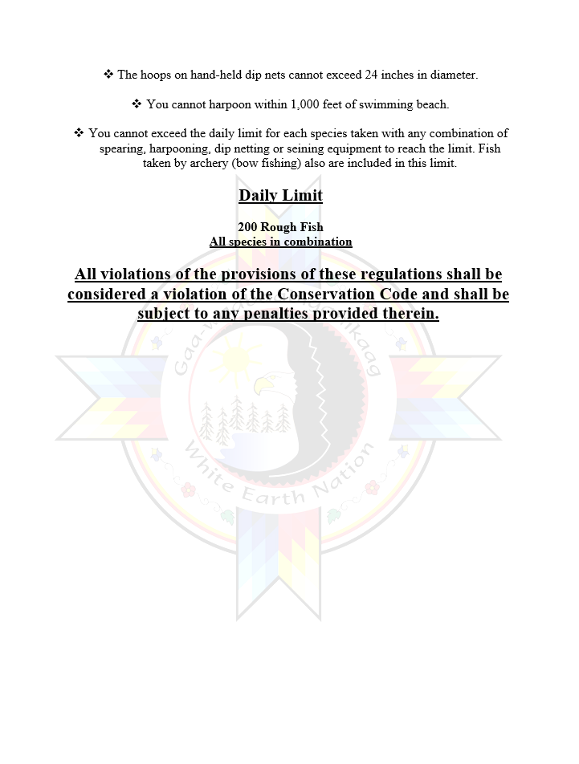
Open Water and Rough Fish Seasons

Slide 18
Angling and Rough Fish Seasons
Daily limits but no in-home possession limits
  No “Freezer Limit”
  No limit on how many fish a member can have in possession at home
  With exception of Lake Sturgeon angling seasons do not close
    Open 365 days of the year
  Rough fish does not close but has time set aside to allow for night spearing of rough fish
    This is designed to maximize harvest during peak runs

Slide 19
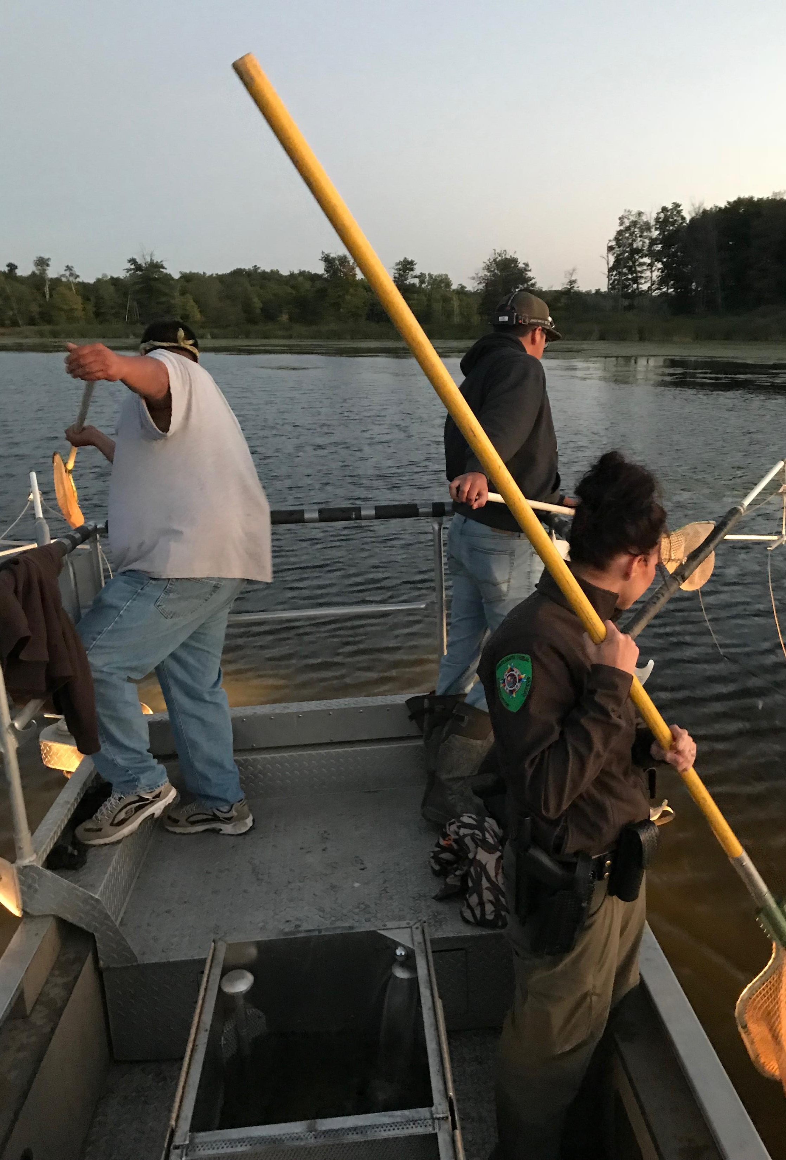
Education And Outreach
Collecting fish for community events such as the Naytahwaush Harvest Festival and other cultural events
Annual Math and Science Program
  Introducing youth to fishing
  Instruction on how to set gill nets and prepare harvested fish
Working with Indian education programs
  Assisted the programs acquiring gill nets
  Provide staff to assist setting/pulling nets for youth to observe
Take a kid and elder fishing events in July/August
Head start ice fishing events for local communities/villages
Actively researching the possibility of a White Fish Stocking Program for White Earth
Manage docks and fishing piers at Big Elbow, North Twin, Little Elbow, Many Point, Roy and White Earth Lakes.
  These outputs provide fishing opportunities for tribal members and actively promote treaty activities and encourage participation for current and future generations

